Slide 1
THE CITY OF HACKER’S
TCOH

Slide 2

Acknowledgement
The success and final outcome of this project required a lot of guidance and assistance from many people and I am extremely privileged to have got this all along the completion of my project. All that I have done is only due to such supervision and assistance and I would not forget to thank them.
I am thankful to and fortunate enough to get constant encouragement, support and guidance from all Teaching staffs of L J BCA which helped us in successfully completing our project work. Also, I would like to extend our sincere esteems to all staff for their timely support
I owe my deep gratitude to our project guide Miss. Gayatri Mam, who took keen interest on our project work and guided us all along, till the completion of our project work by providing all the necessary information for developing a good system.

Slide 3
Index
NEXT PAGE
Screen Layouts 05
Landing Page (Home) 10
Pricing Page 12
About Us Page 14
Tools Page 17
Study Page 19
Contact Page 21
Login Page 22
Signup Page 23
Profile Page After Login 24
Admin Login (Page) 39
Report Layouts 32
Login Page (User/Hacker) 33
Login Page (Admin Panel) 34
Registration Page (User/Hacker) 48
After Login Effects(User/Hacker) 52
Profile Chip 52

Slide 4
Index
Previous Index
Not Empty Field Validation 53
Password Changing 54
Edit Profile 55
Course Upload 57
After Login Effects(Admin Panel) 59
Profile Update And View 59
Showing Details From DB 59
Registration Details Report 60
Course Uploaded Report 61
Query Form Uploaded Report 62
Take Location Of Users Report 63
Tracking location of users 64
Register New Admin From Main 65
Conclusion 66
Bibliography 68

Slide 5
THE CITY OF HACKER’S
Screen Layouts

Slide 6

Landing Page(Home)

Slide 7

Landing Page(Home)

Slide 8
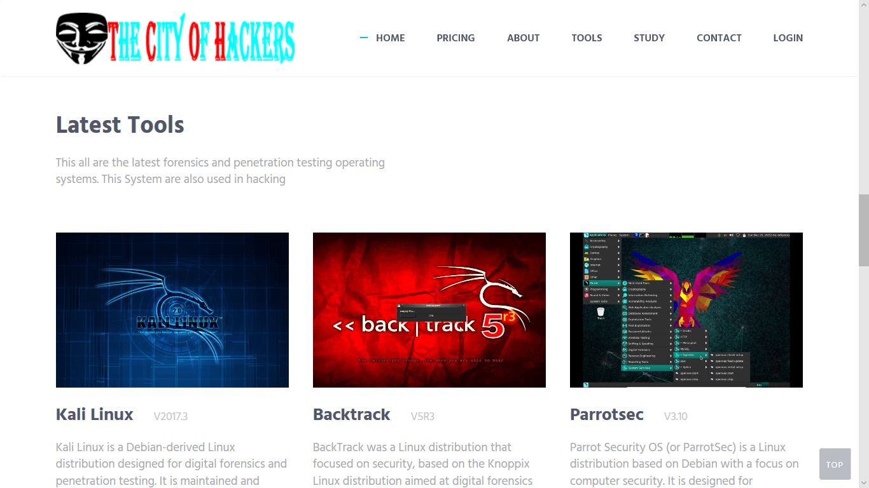
Landing Page(Home)

Slide 9
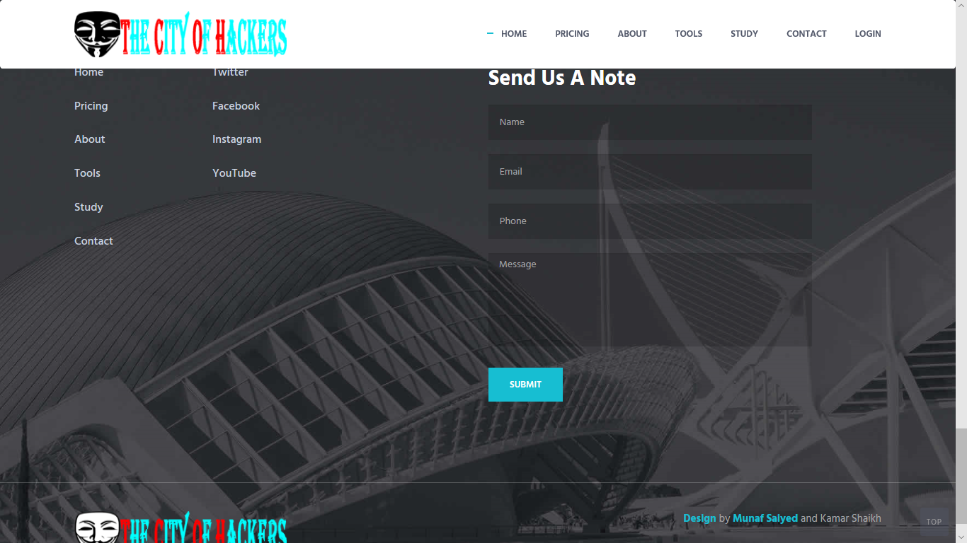
Landing Page(Home)
Footer

Slide 10

Pricing Page

Slide 11
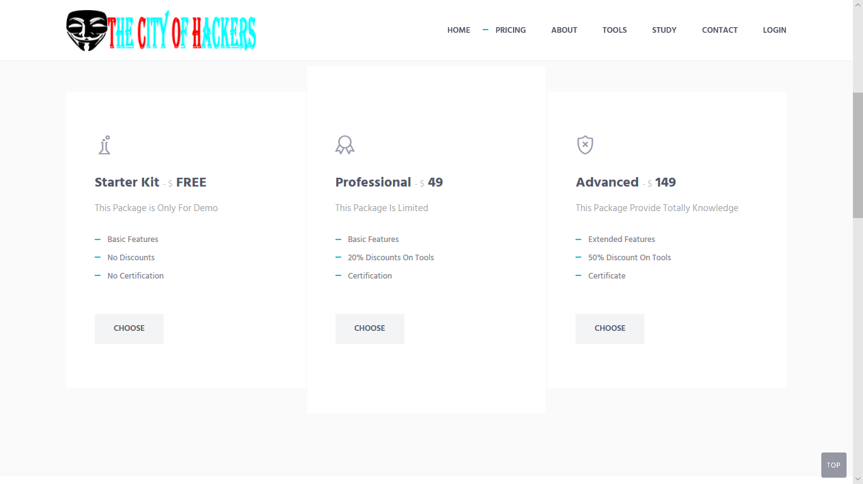
Pricing Page

Slide 12
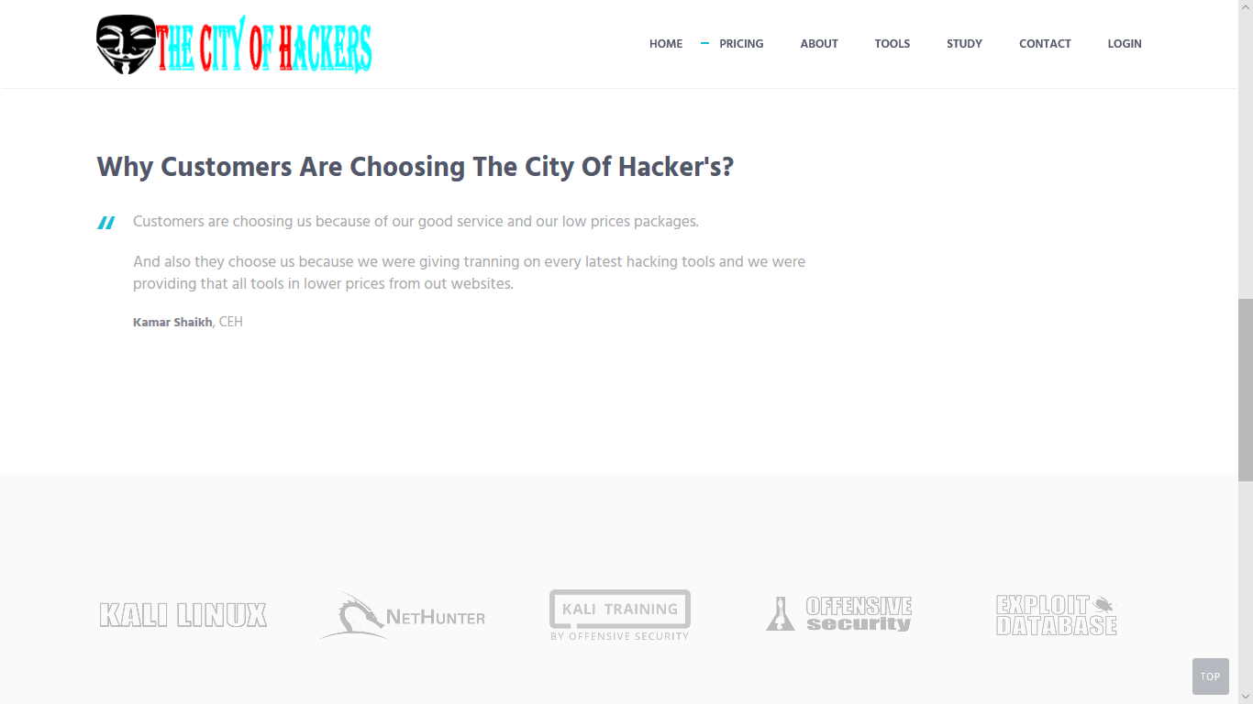
Pricing Page

Slide 13
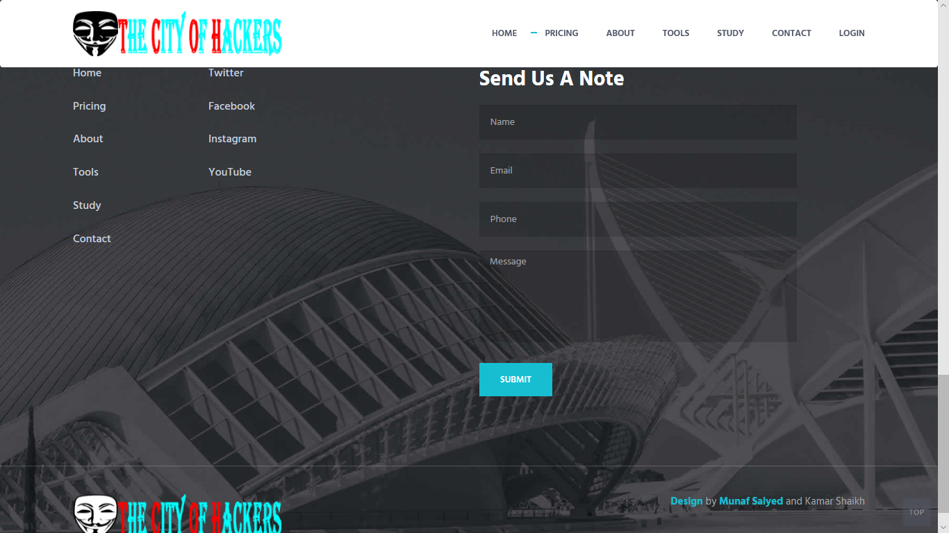
Pricing Page
Footer

Slide 14

About Us (Page)

Slide 15

About Us (Page)

Slide 16

About Us (Page)

Slide 17
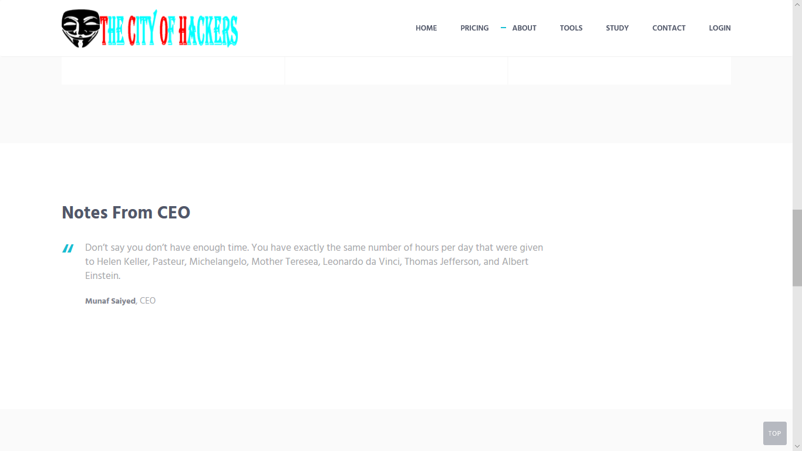
About Us (Page)

Slide 18
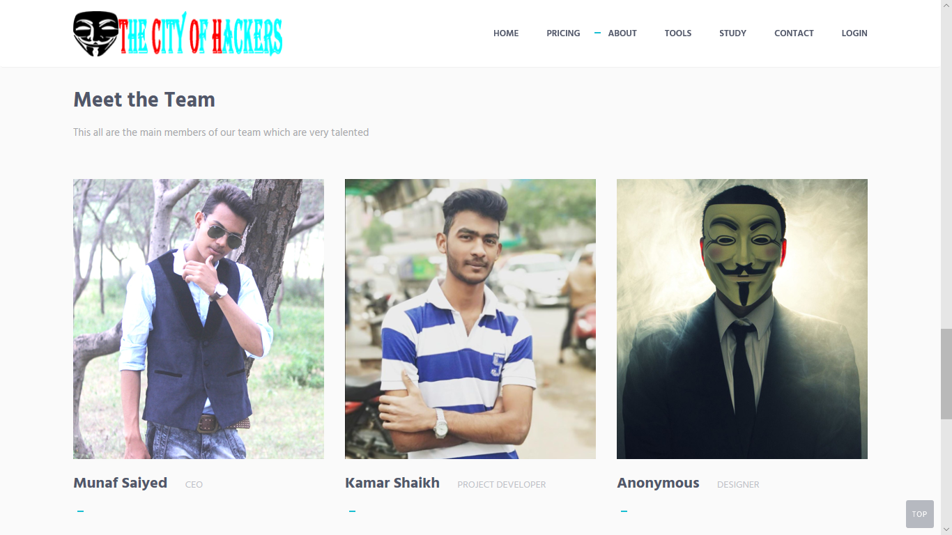
About Us (Page)

Slide 19
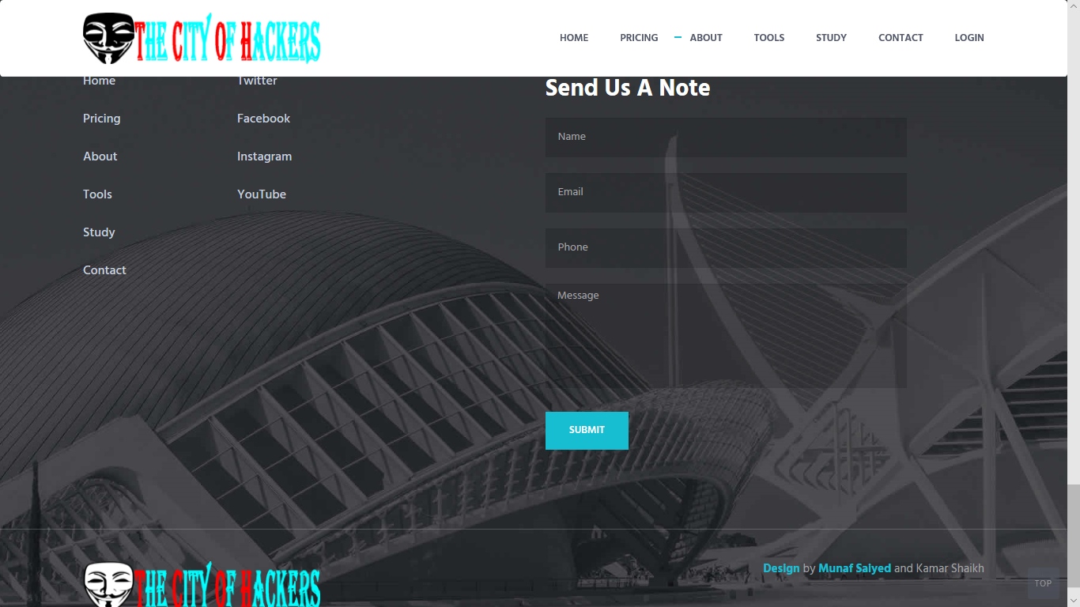
About Us (Page)
FOOTER

Slide 20

Tools (Page)

Slide 21

Tools (Page)

Slide 22

Tools (Page)
FOOTER

Slide 23
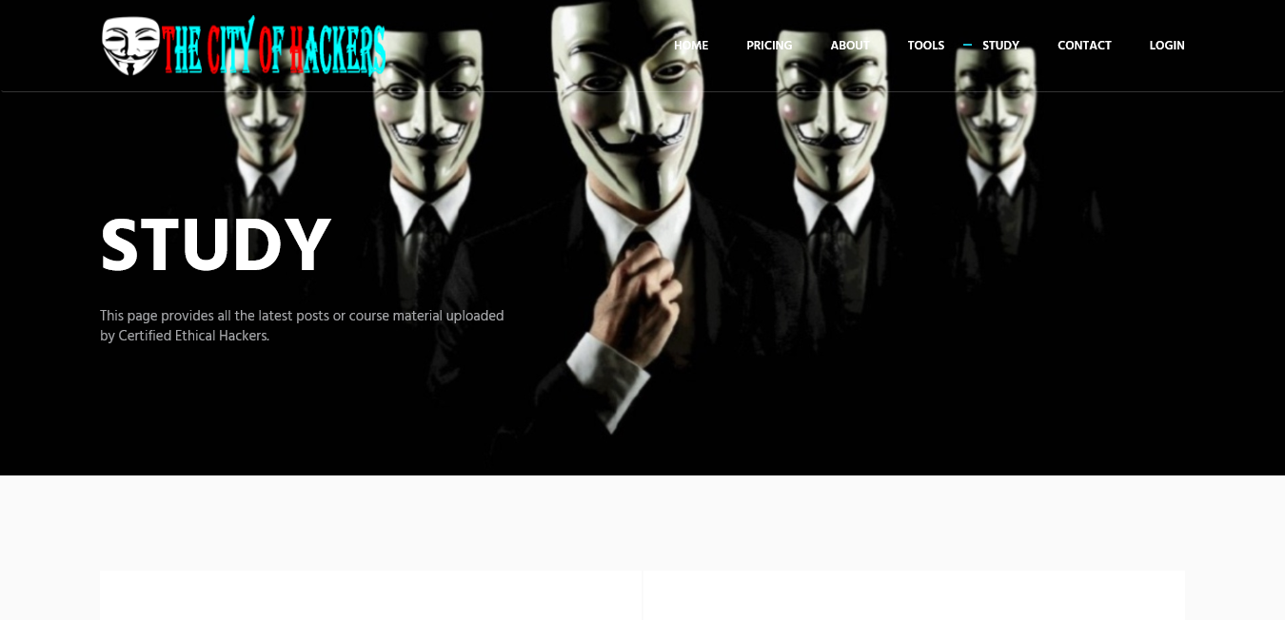
Study (Page)

Slide 24
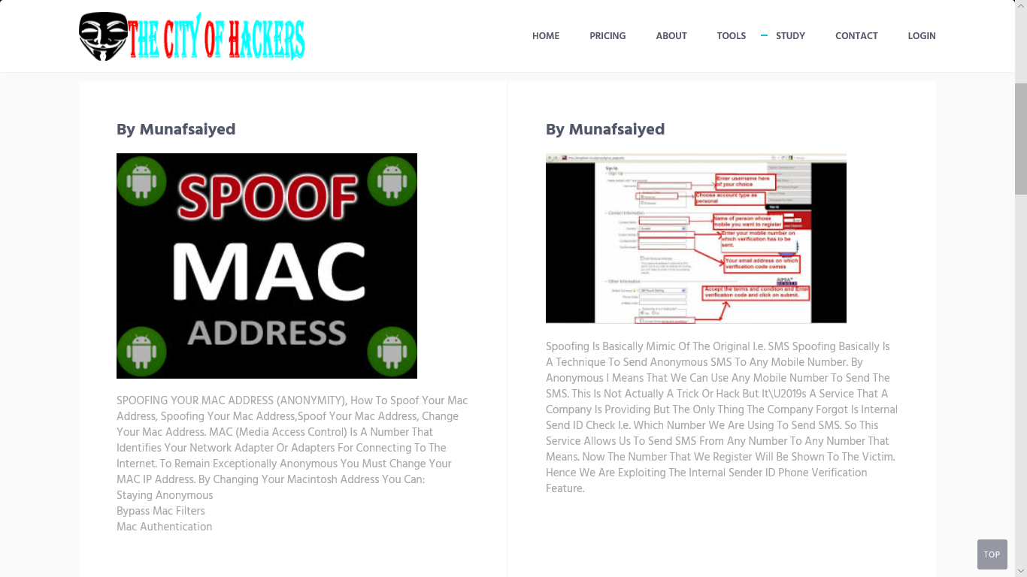
Study (Page)

Slide 25

Study (Page)

Slide 26

Study (Page)
FOOTER

Slide 27
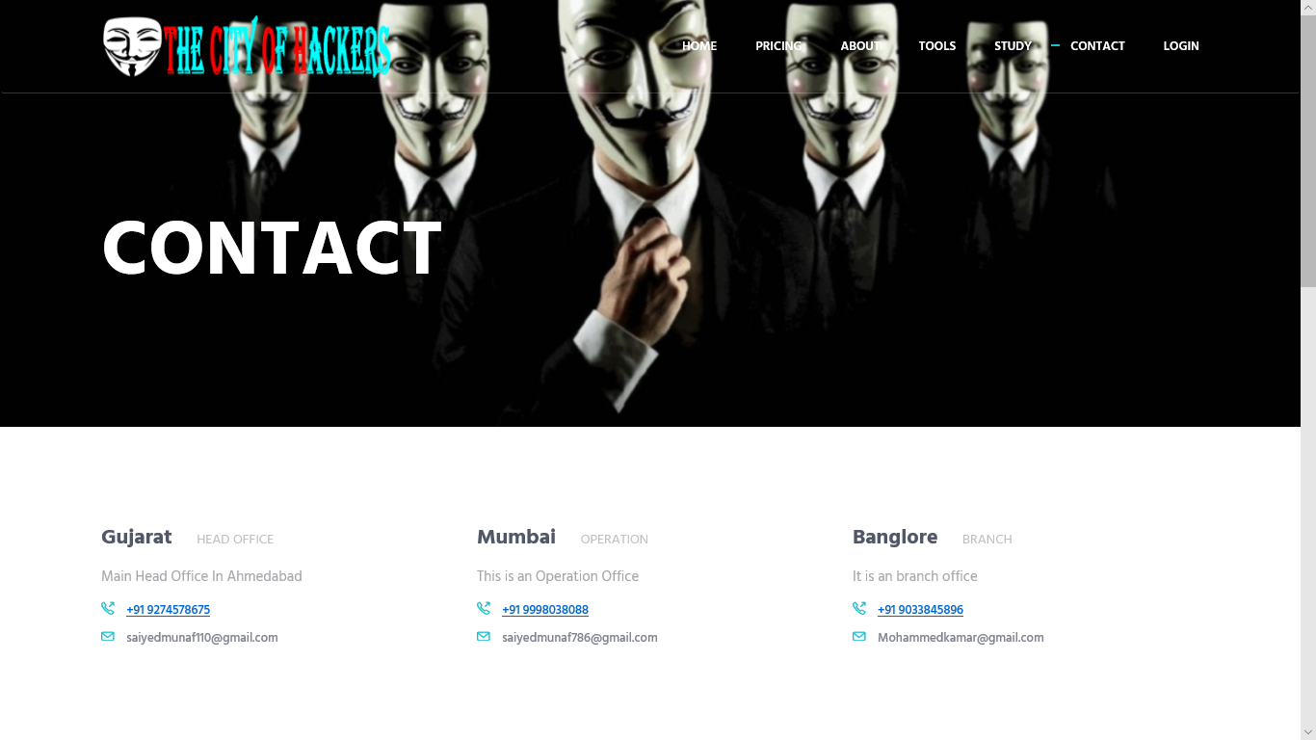
Contact (Page)

Slide 28
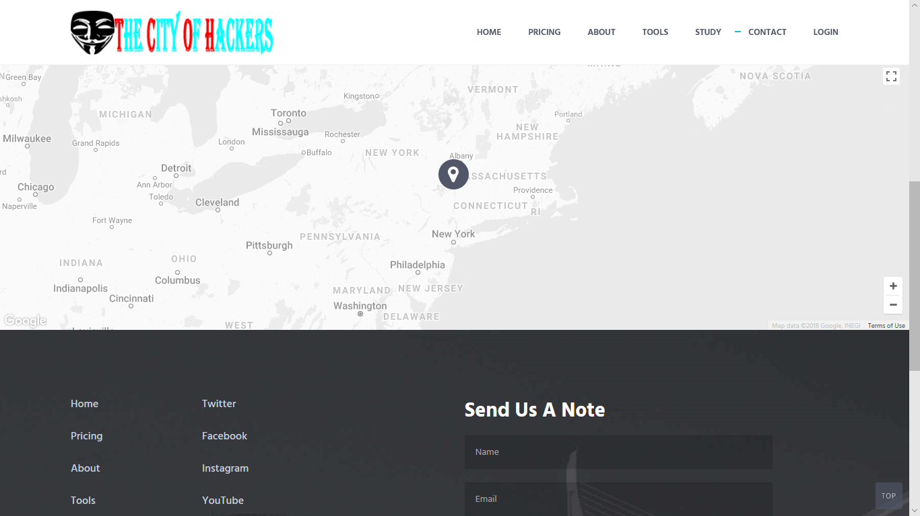
Contact (Page)

Slide 29
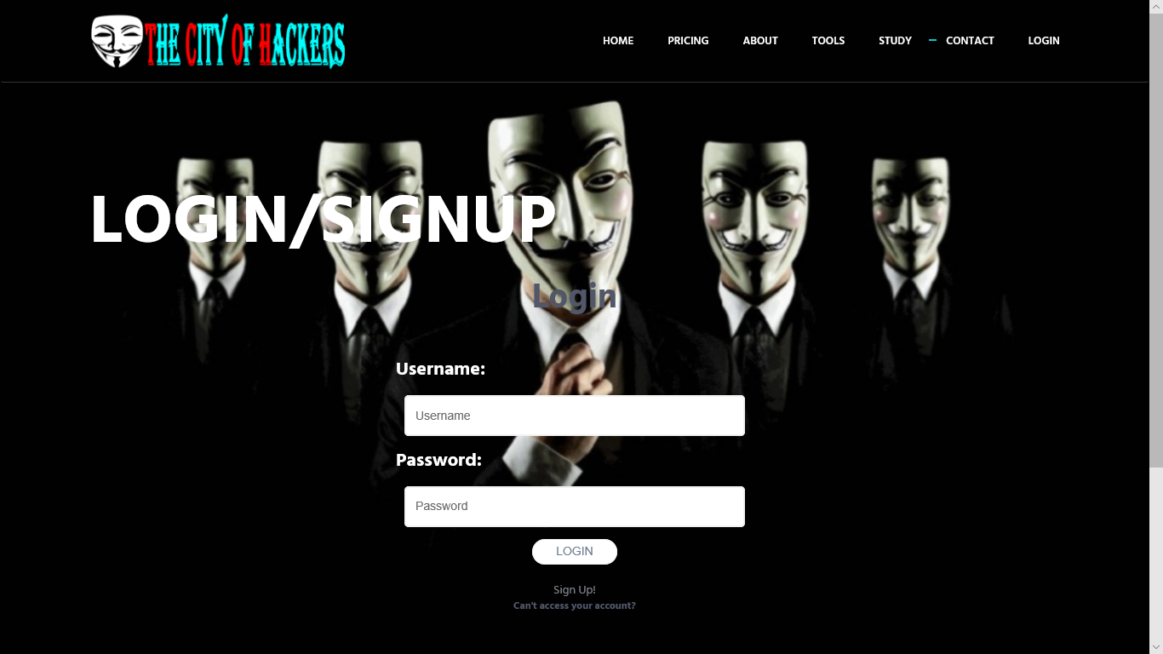
Login (Page)

Slide 30

SignUp (Page)

Slide 31
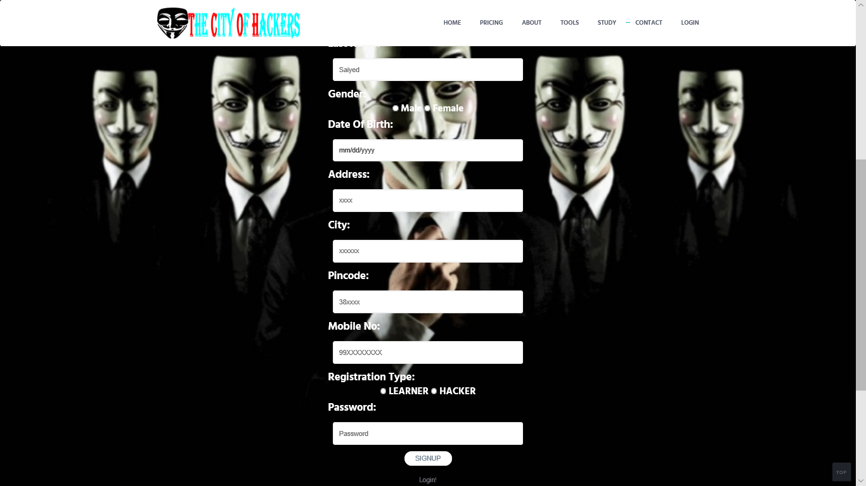
SignUp (Page)

Slide 32
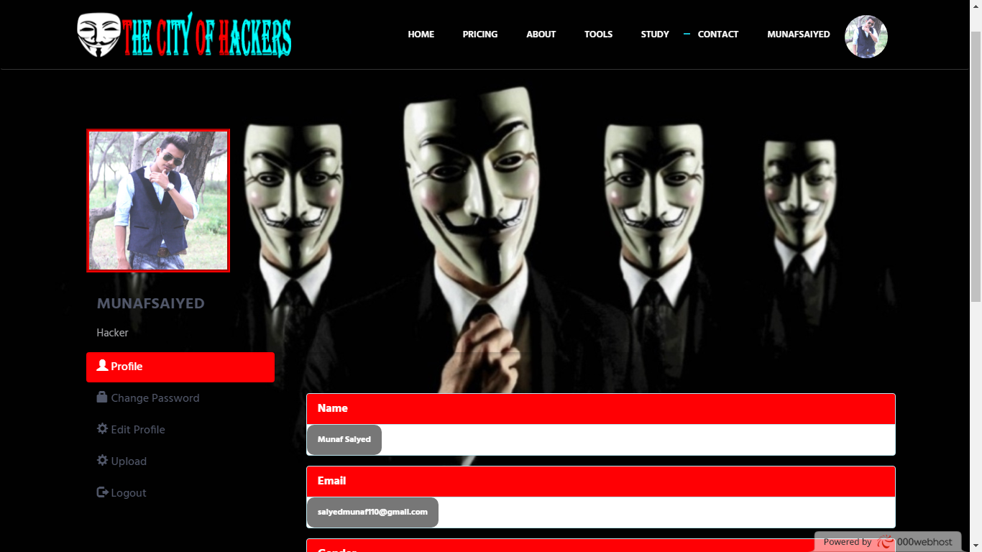
Profile (Page) After Login

Slide 33
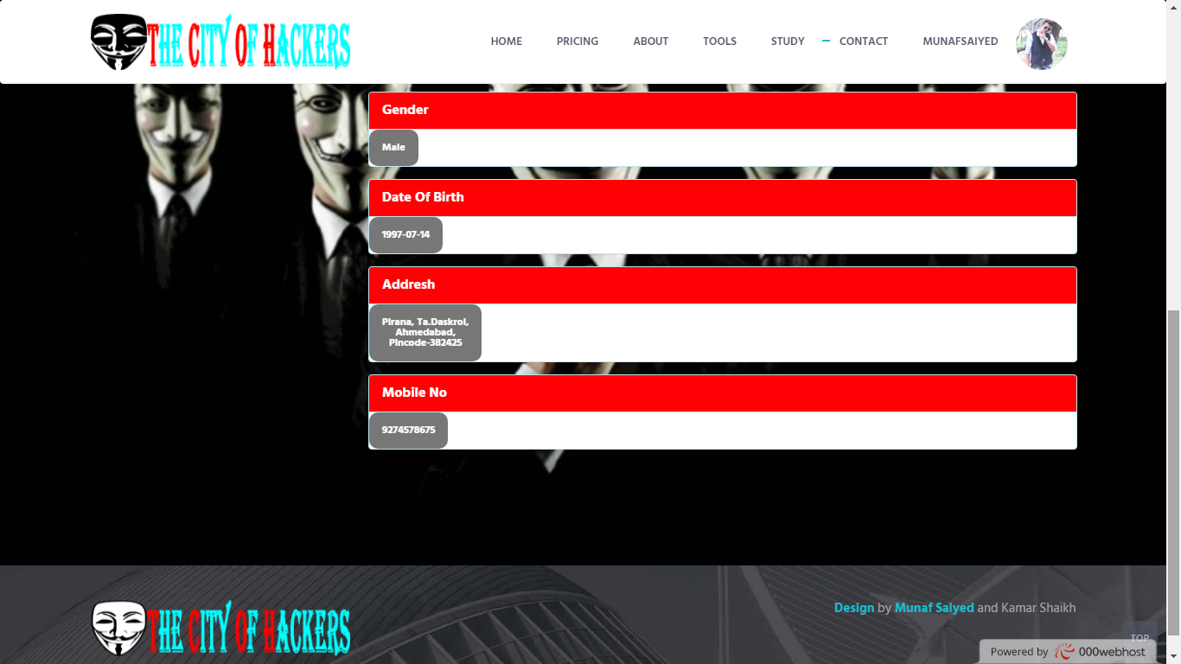
Profile (Page) After Login

Slide 34
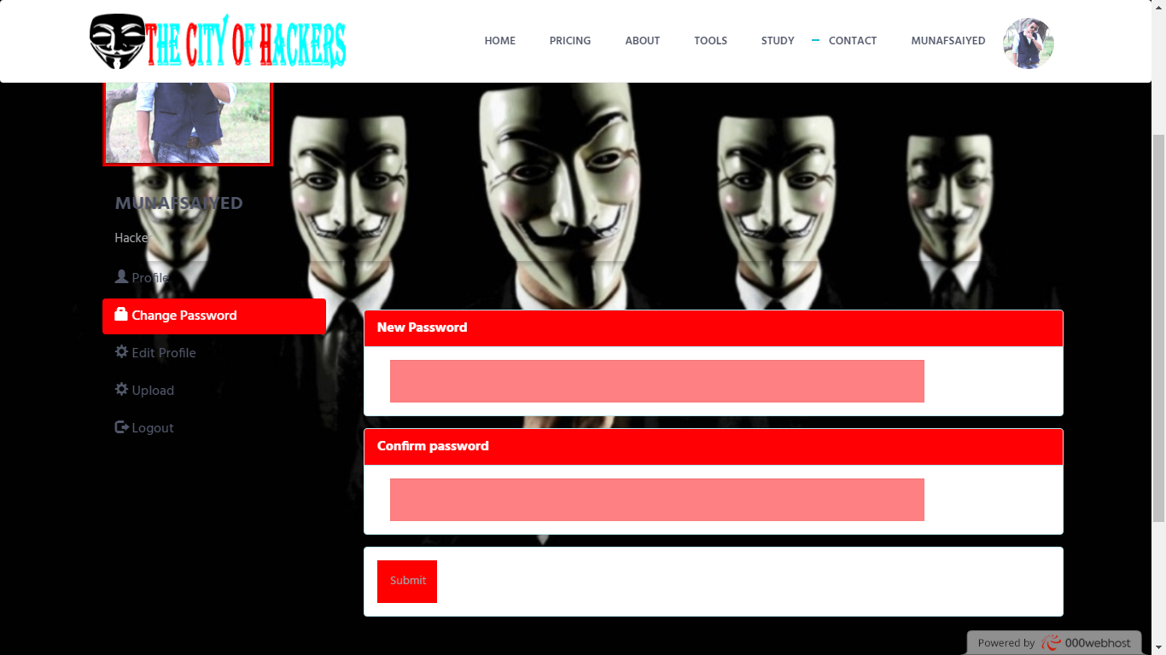
Profile (Page) After Login
Change Password Tab

Slide 35
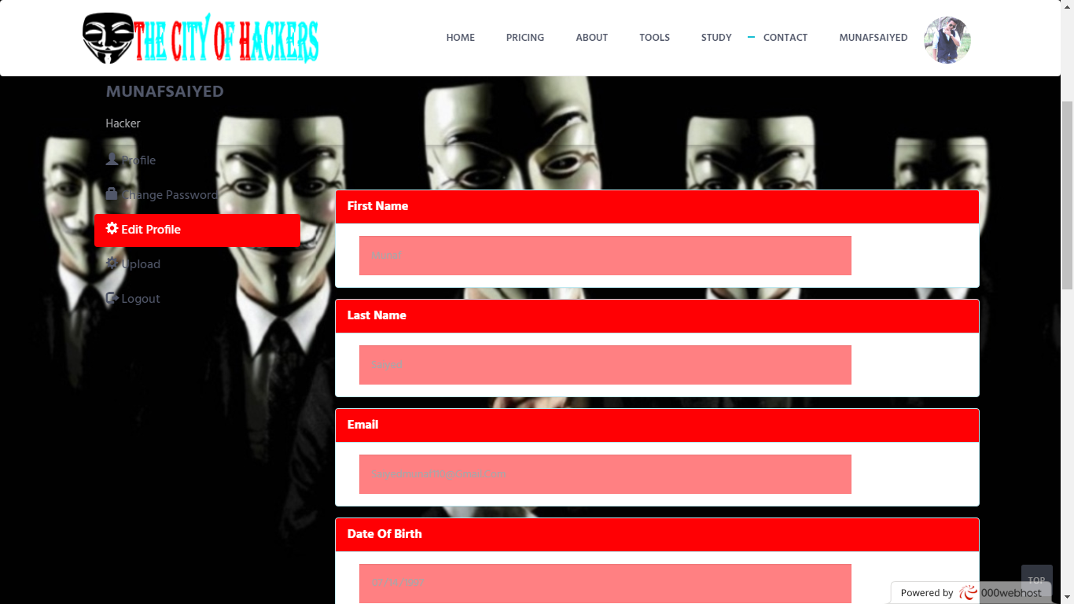
Profile (Page) After Login
Edit Profile Tab

Slide 36
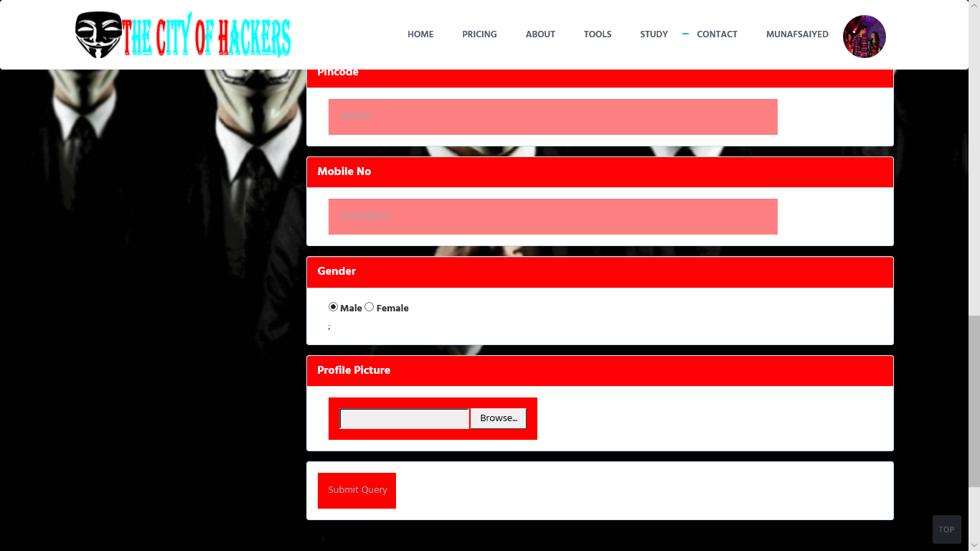
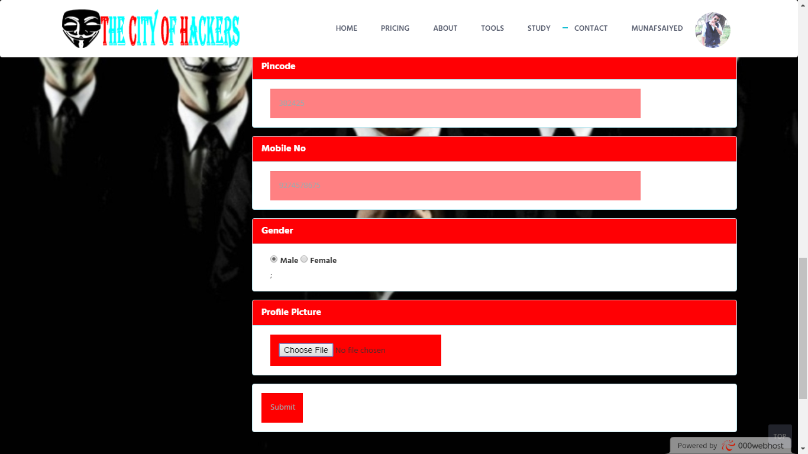
Profile (Page) After Login
Edit Profile Tab

Slide 37
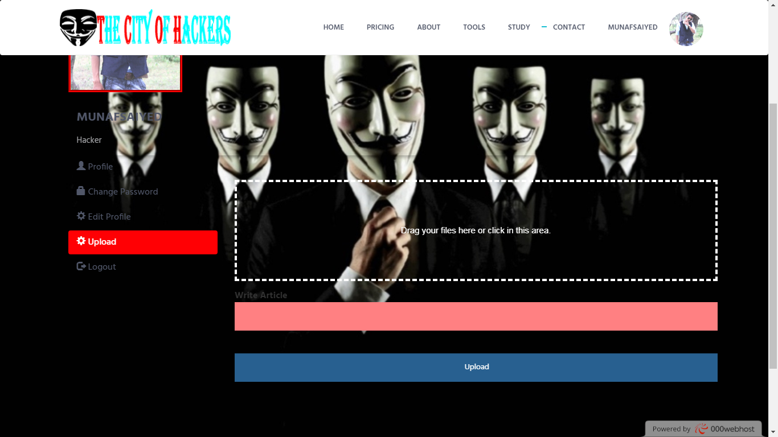
Profile (Page) After Login
Upload Tab Only For Hackers Login

Slide 38
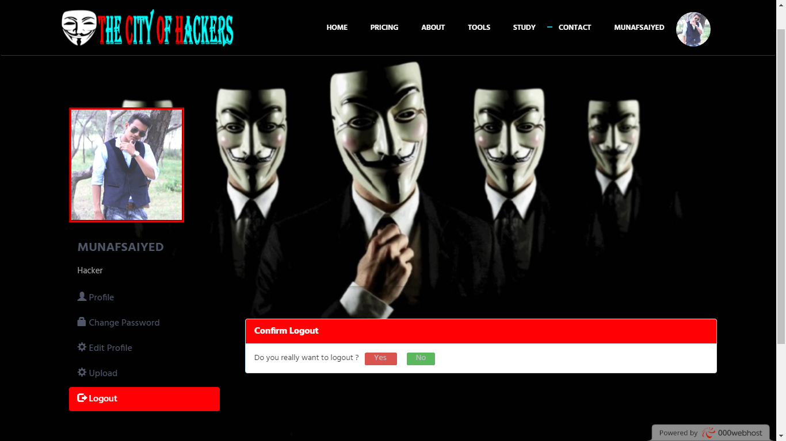
Profile (Page) After Login
Logout Tab

Slide 39
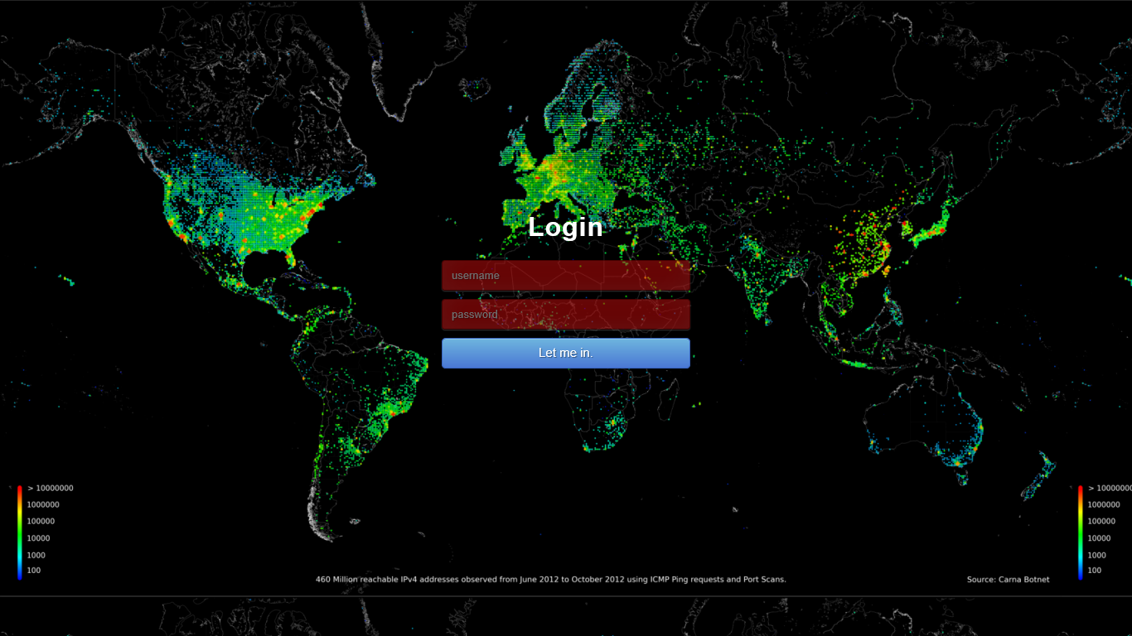
Admin Login (Page)

Slide 40
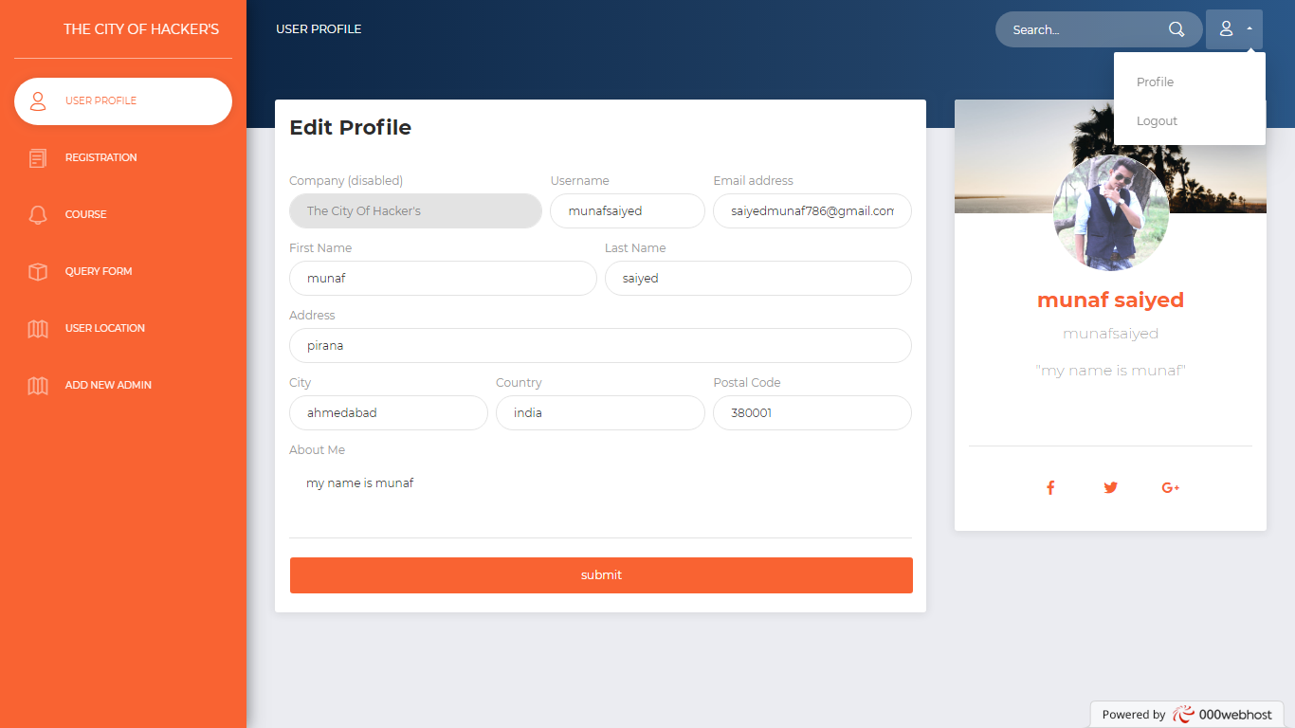
Admin Panel Profile (Page)

Slide 41
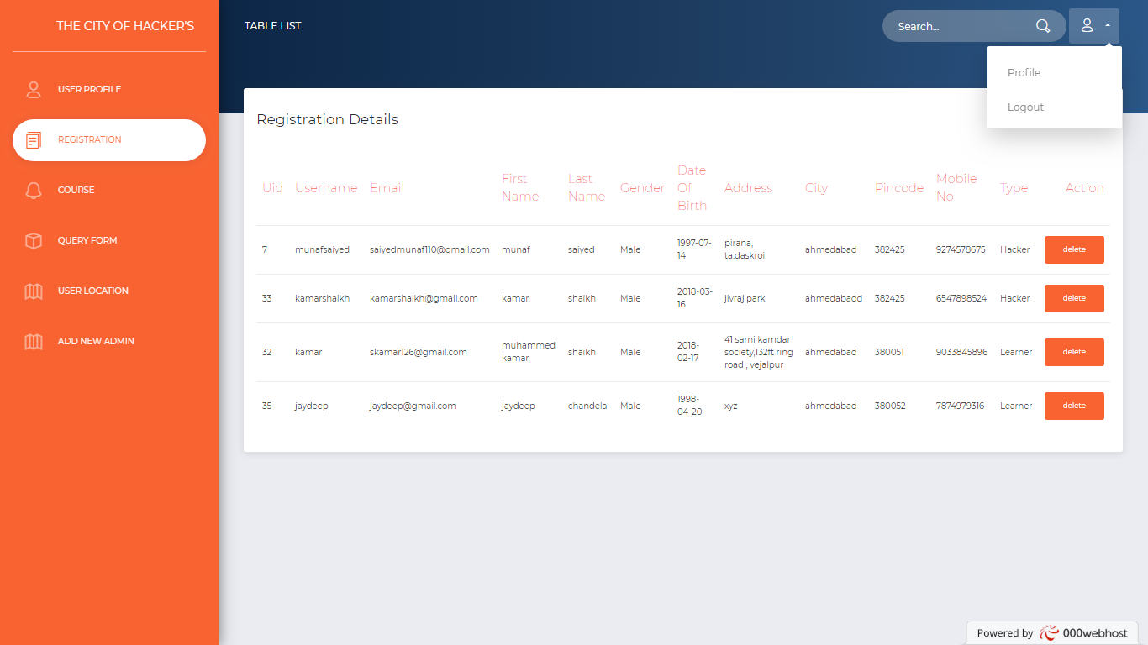
Admin Panel Registration Details(Page)

Slide 42
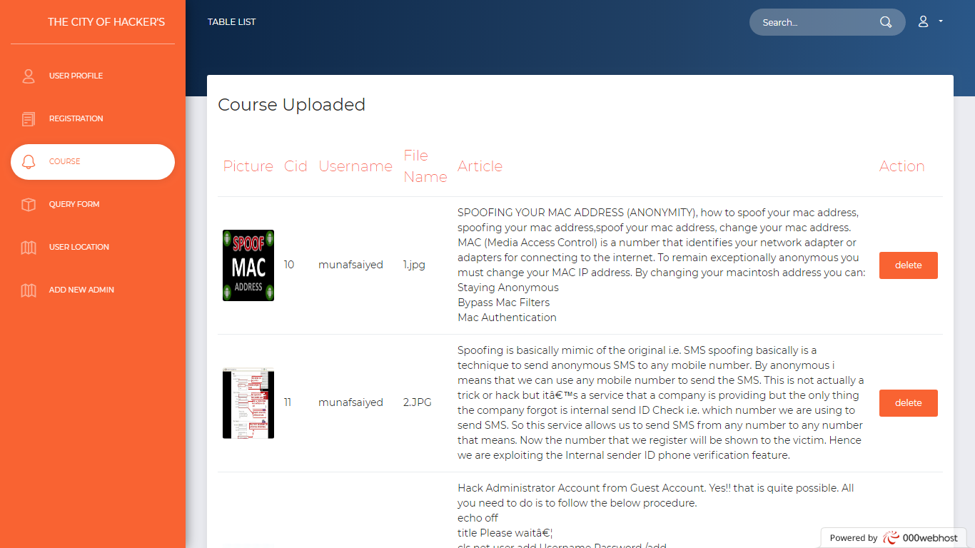
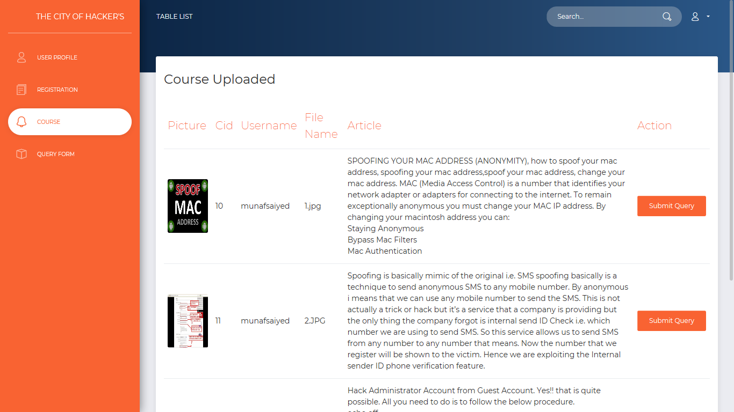
Admin Panel Course details(Page)

Slide 43
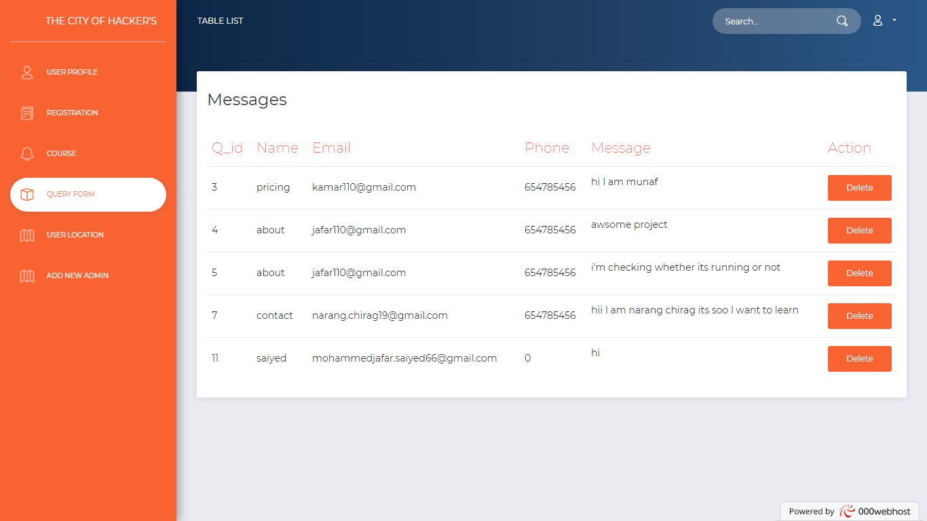
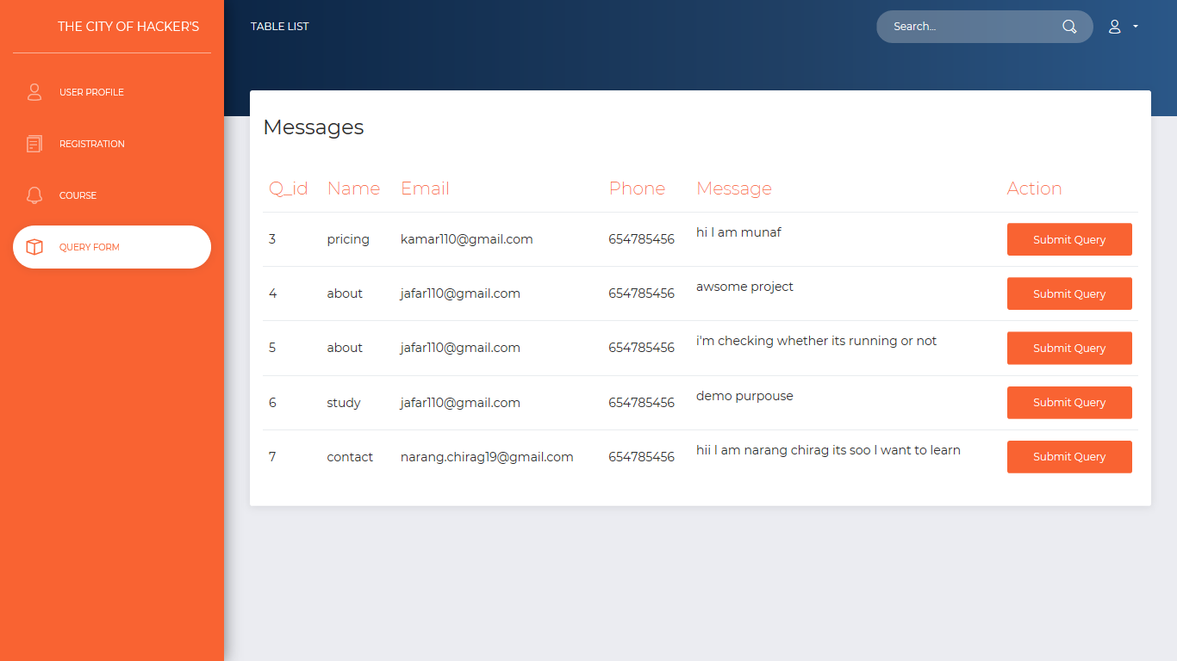
Admin Panel Query Form(Page)

Slide 44
THE CITY OF HACKER’S
Report Layouts

Slide 45
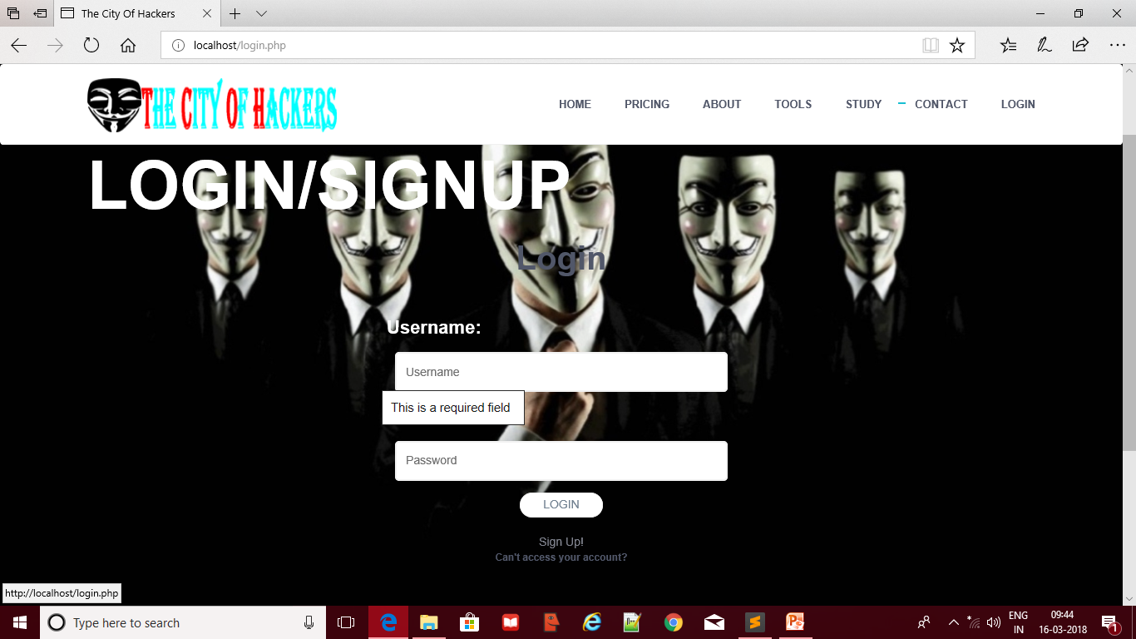
Login Page (User/Hacker)
Not Empty Validation

Slide 46
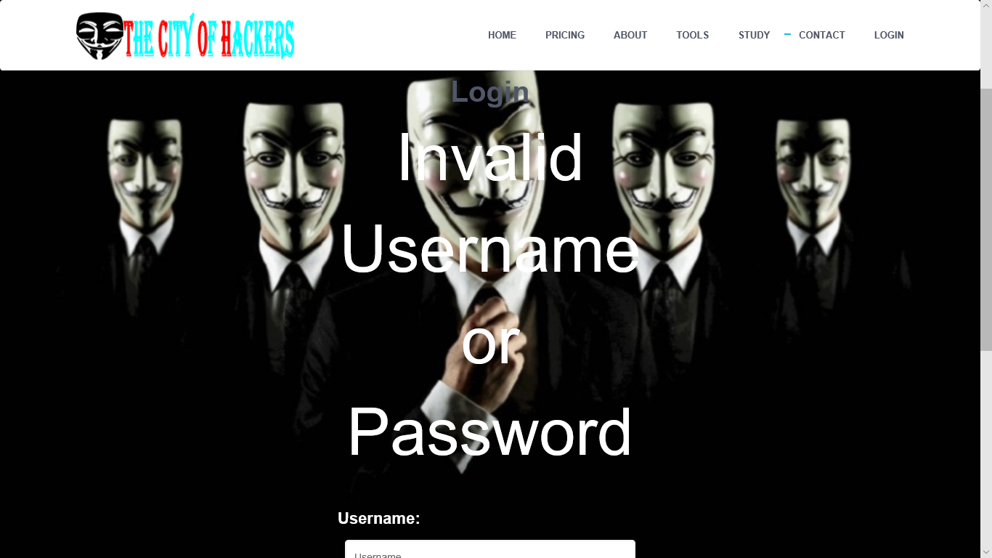
Login Page (User/Hacker)
Invalid Username &Password

Slide 47
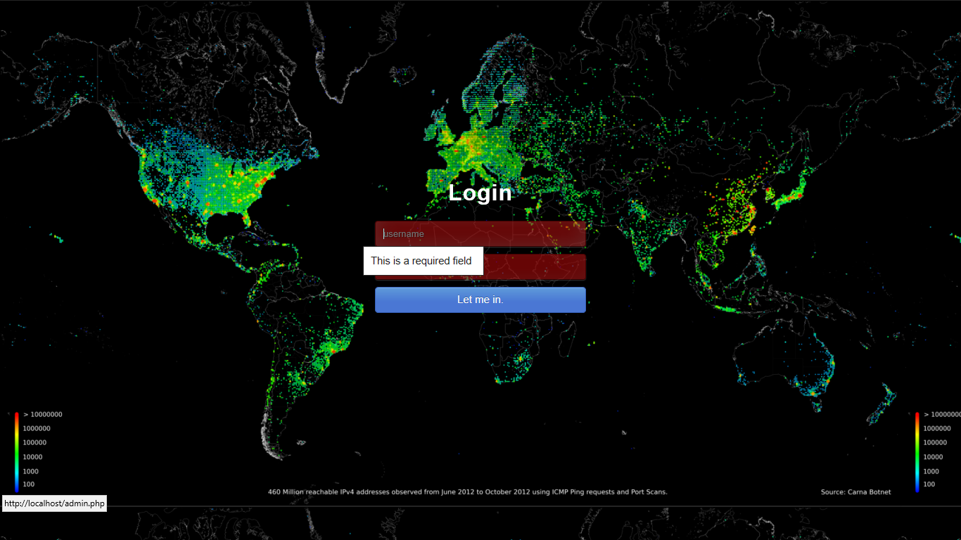
Login Page (Admin Panel)
Not Empty Validation

Slide 48
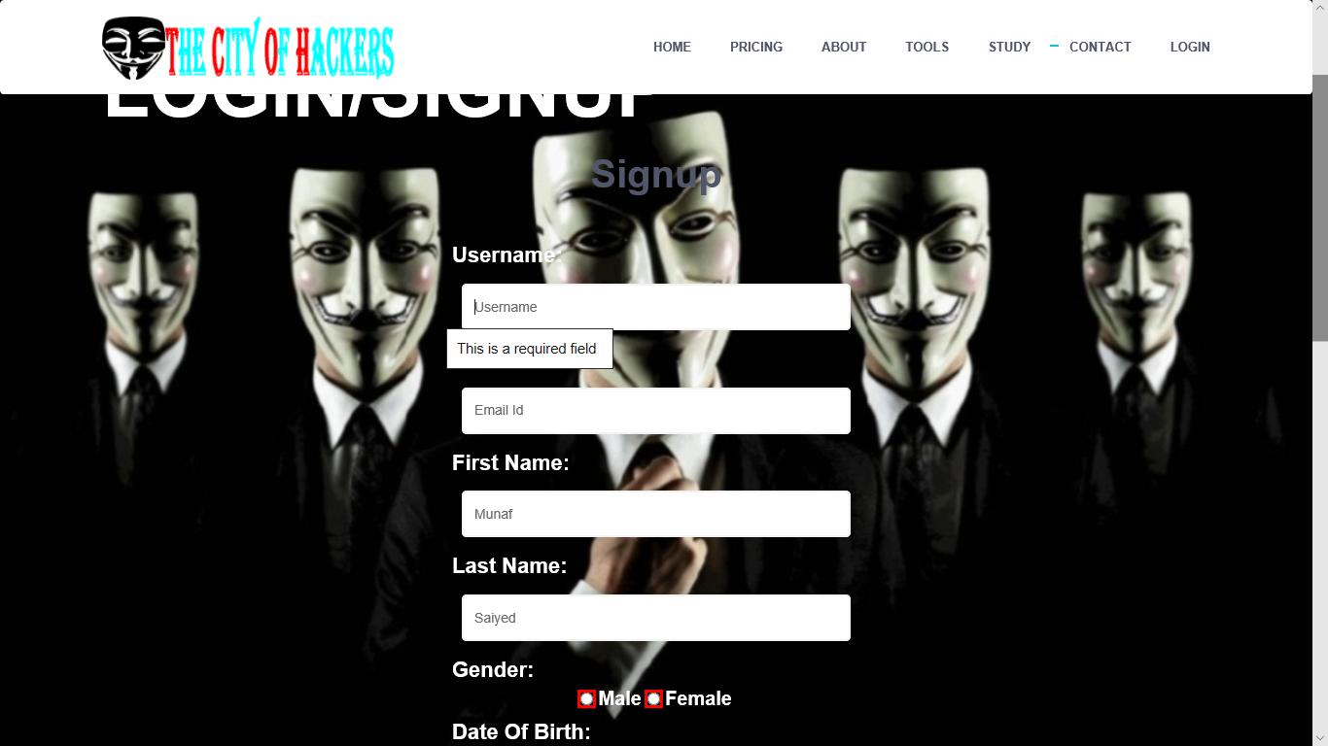
Registration Page (User/Hacker)
Not Empty Validation

Slide 49
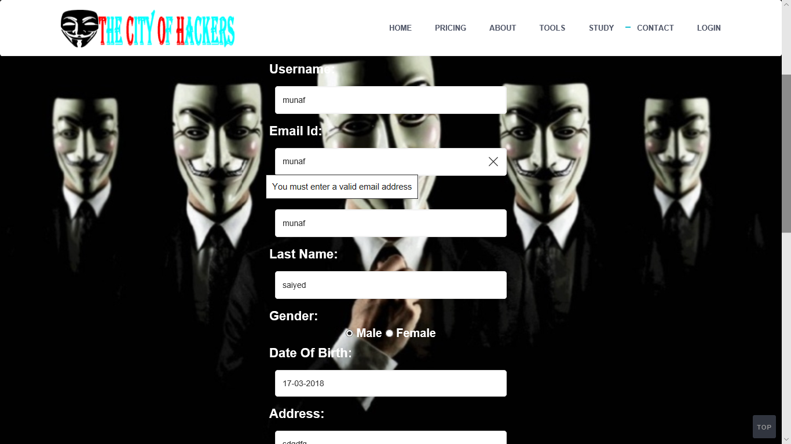
Registration Page (User/Hacker)
Valid Email Validation

Slide 50
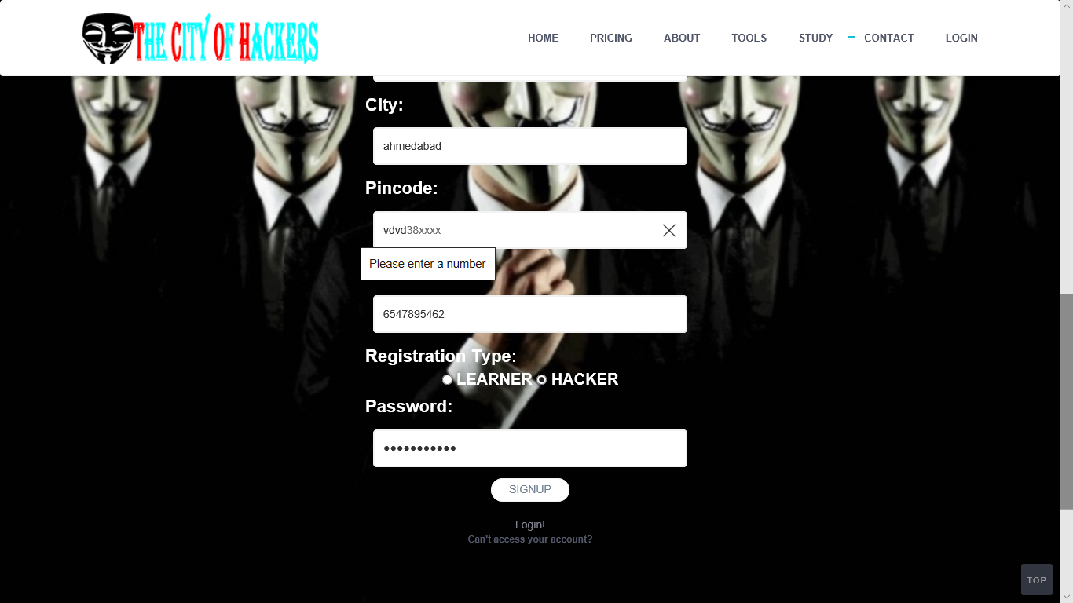
Registration Page (User/Hacker)
Valid Number Validation

Slide 51
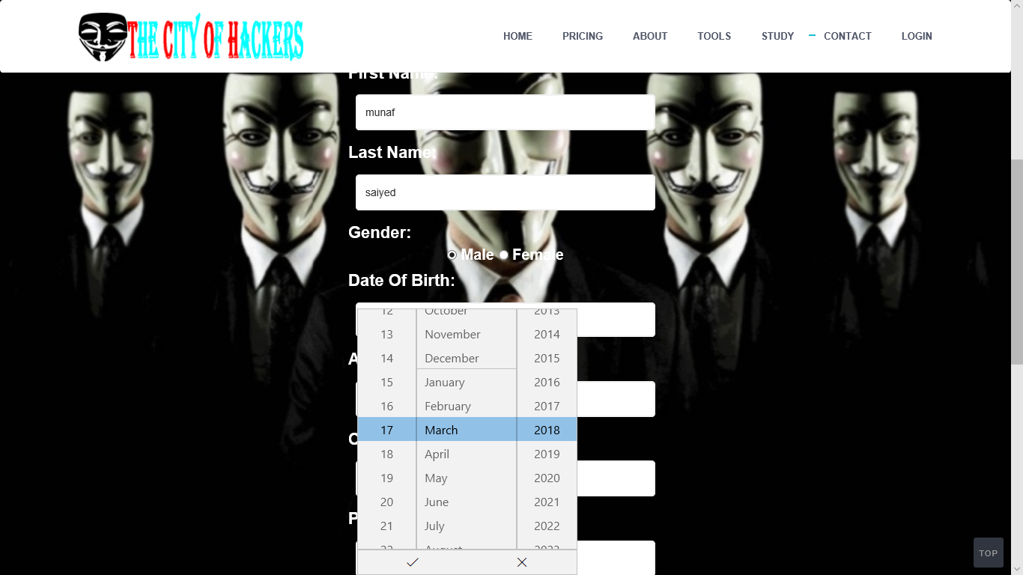
Registration Page (User/Hacker)
Valid Date Validation

Slide 52

After Login Effect (User/Hacker)
Profile Chip

Slide 53
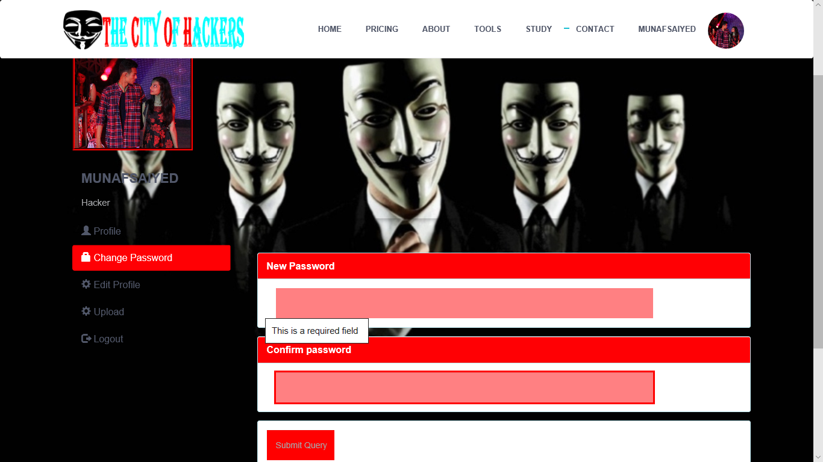
After Login Effect (User/Hacker) Password Changing
Not Empty field Validation

Slide 54
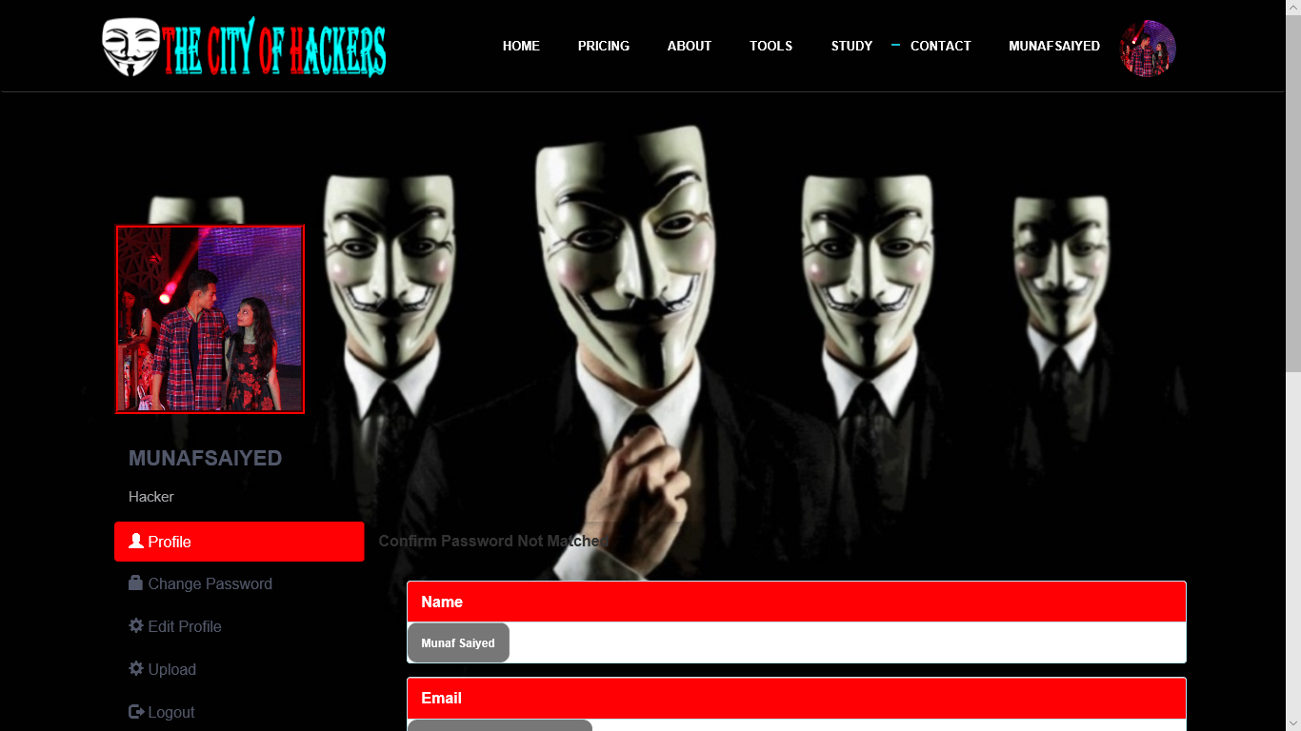
After Login Effect (User/Hacker) Password Changing
Confirm password not matched validation

Slide 55
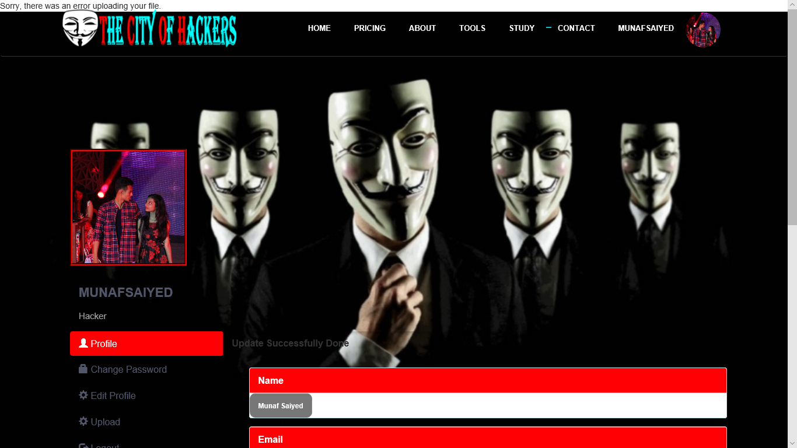
After Login Effect (User/Hacker) Edit Profile
Update Profile Data With profile pic Not Upload data error

Slide 56
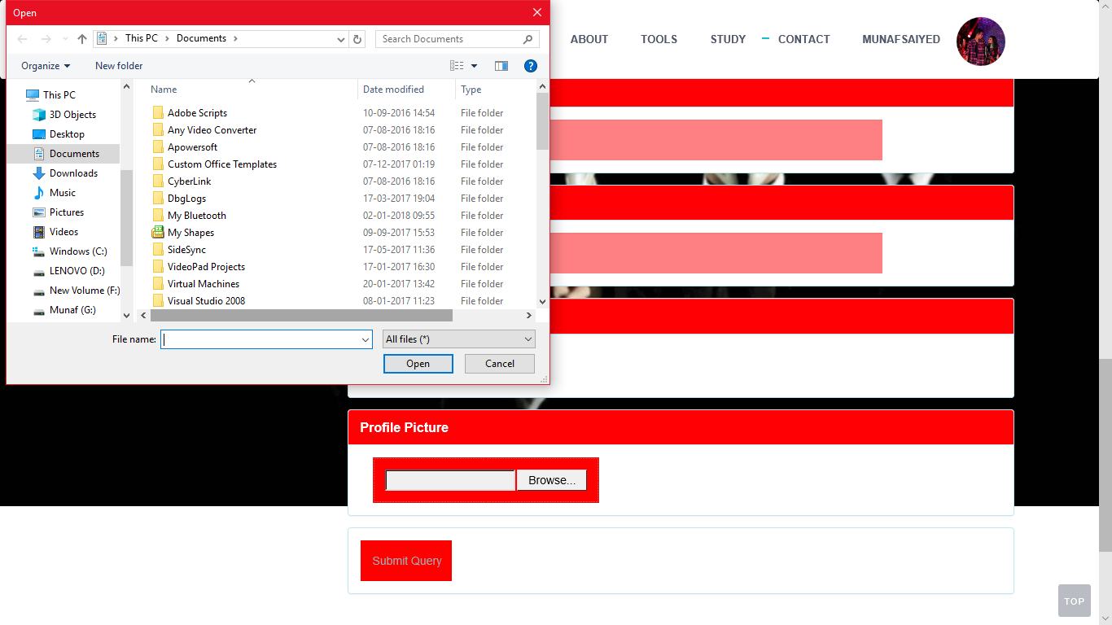
After Login Effect (User/Hacker) Edit Profile
Uploading Profile Pic

Slide 57
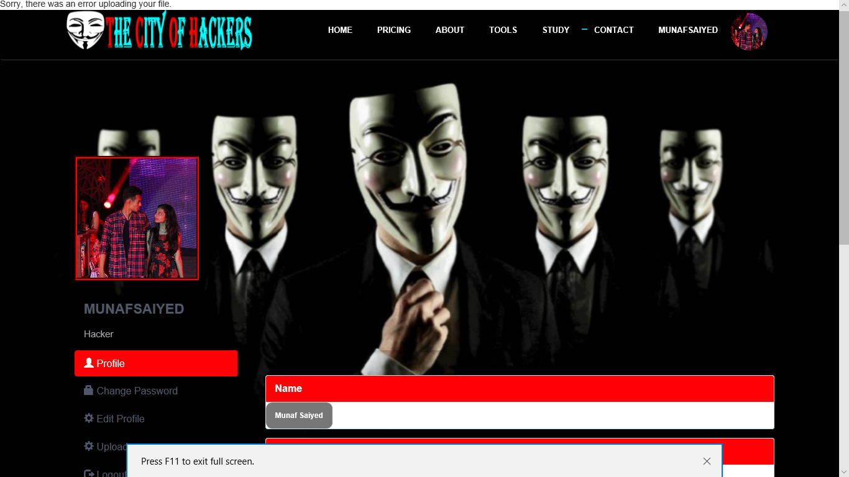
After Login Effect (User/Hacker) Course Upload
Uploading empty file validation

Slide 58

After Login Effect (User/Hacker) Course Upload
Successfully course upload

Slide 59
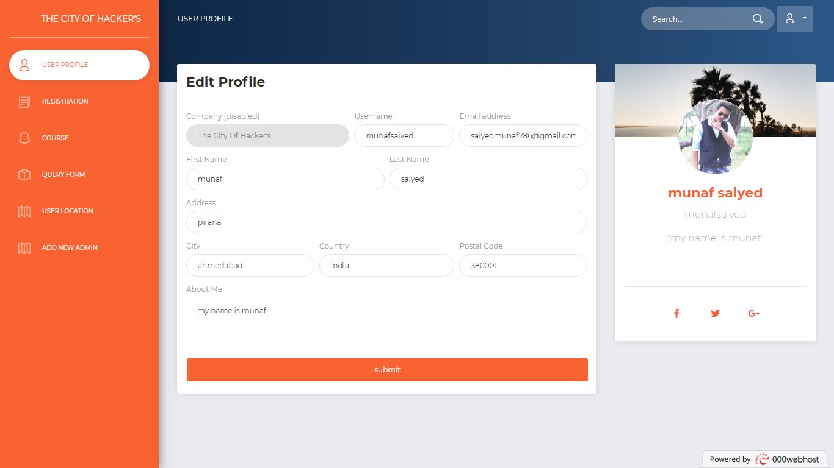
After Login Effect (Admin Panel) Profile Update and view
Showing profile details from Database

Slide 60
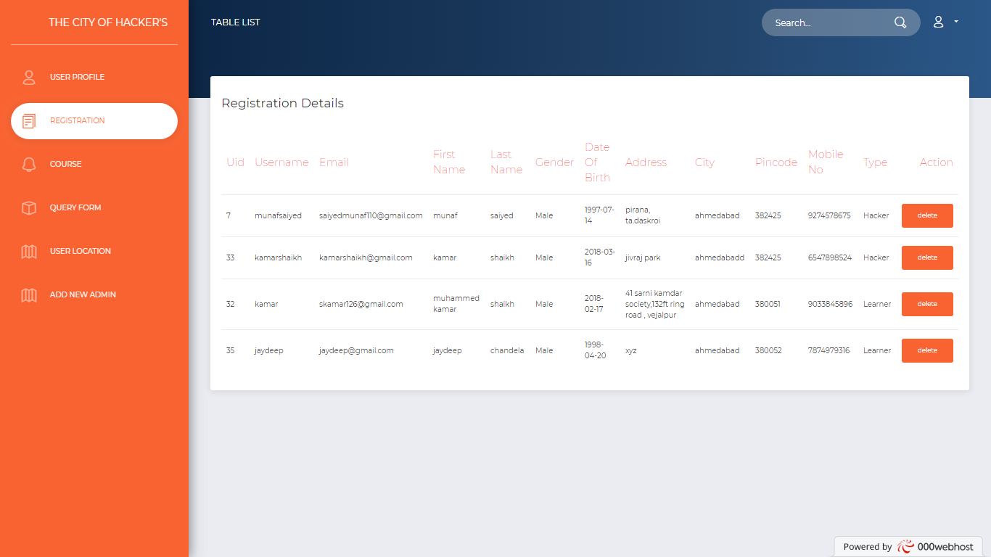
After Login Effect (Admin Panel)
Registration Details Report

Slide 61
After Login Effect (Admin Panel)
Course Uploaded Report

Slide 62
After Login Effect (Admin Panel)
Query Form Uploaded Report

Slide 63
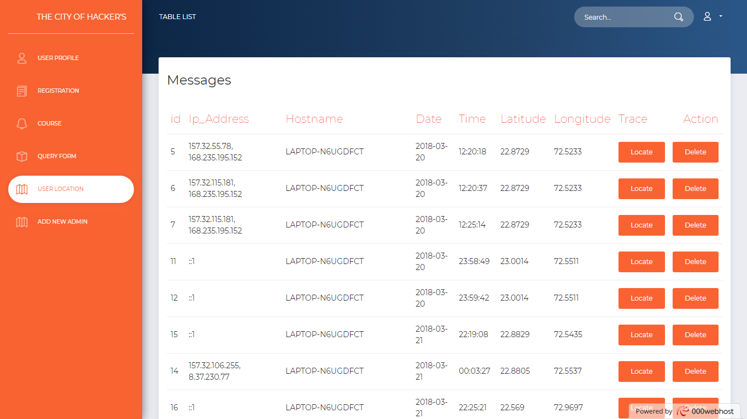
After Login Effect (Admin Panel)
Take Location Of Users

Slide 64
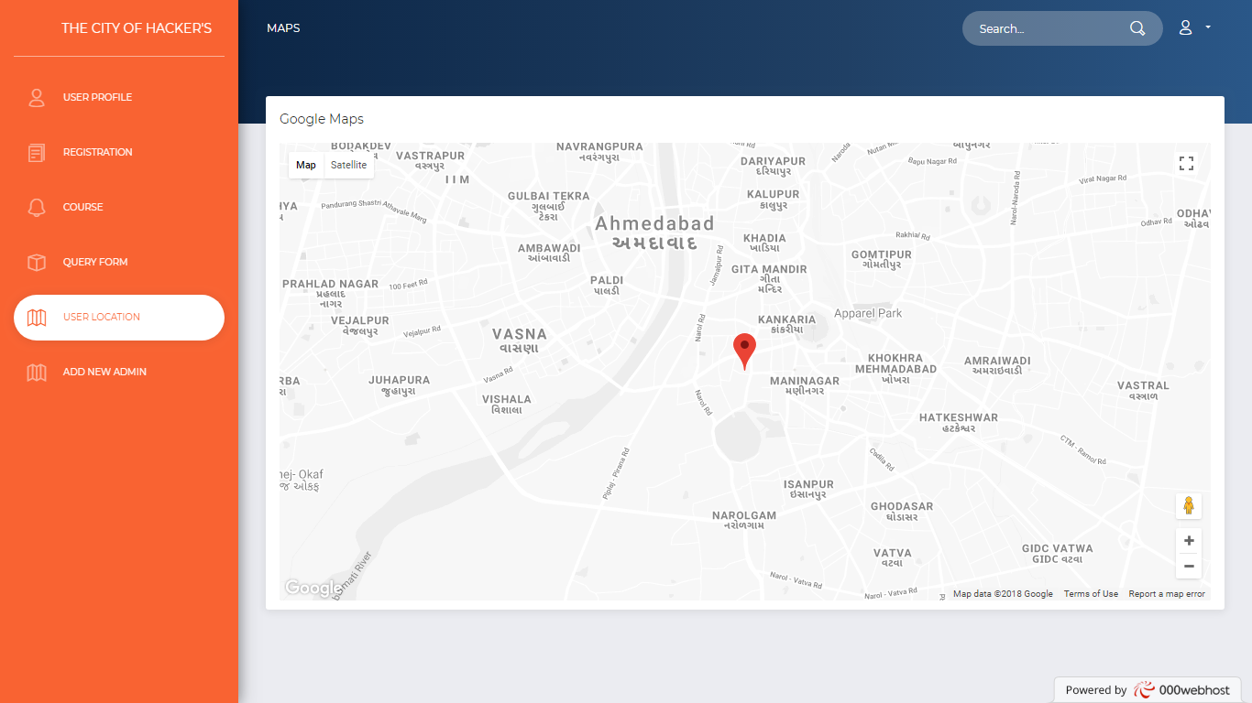
After Login Effect (Admin Panel)
Tracking Location Of Users

Slide 65
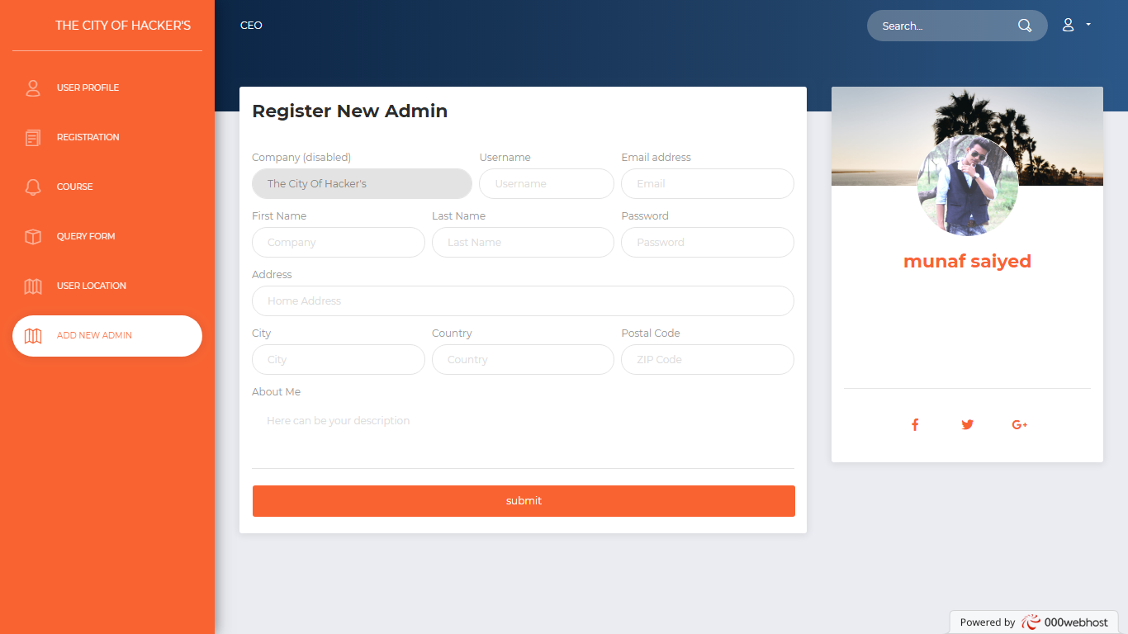
After Login Effect (Admin Panel)
Register New Admin
Its Done By Only Main Admin

Slide 66
THE CITY OF HACKER’S
CONCLUSION

Slide 67
CONCLUSION
The project “The City Of Hacker’s” was handed to us in the start of the 5th Semester and was expected to be completed in a year. In order to complete this project we have gone through several websites and several books of PHP and My SQL Server. While going through these books we enhanced our limited knowledge on these vast subjects which was not achieved through our semester papers.
We have definitely gained a lot from this project as we come to know how to use PHP and My SQL Server which were never known to us. Now we able to make websites on any given requirement and these are all possible after we have done this project.

Slide 68
Bibliography
These are the following links which assist me at each and every step in completing this project, without them I was not being able to finish this importance project:
1. www.google.com
2. www.youtube.com
3. www.wikipedia.com
4. www.w3school.com

